Slide 1
Today
Chapter 7 objectives
Understand how LOH contributes to loss of tumor suppressor function
Be able to describe 4 ways to achieve LOH
Know what the consequences of LOH are on:
Each allele of the tumor suppressor
Each allele of a neighboring gene on the same chromosome
Each allele of a distant gene on the same chromosome
The appearance of the effected chromosome by karyotype analysis

Slide 2
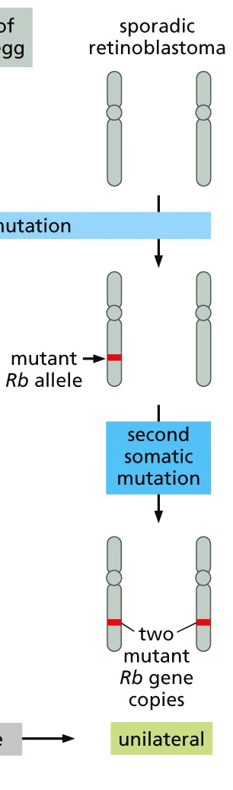
Heterozygosity of tumor suppressors
One ‘good’ copy + one ‘bad’ copy = heterozygosity
Loss of the remaining ‘good’ copy = loss of heterozygosity (LOH)
How could this LOH happen?
The timeline for retinoblastoma doesn’t fit with the decades needed for random acquisition of a mutation

Slide 3
Similarities and differences
LOH mechanism | # different tumor suppressor alleles? | # different non cancer gene alleles on chromosome | What stage of the cell cycle does this event happen? | changes obvious by Karyotype analysis?
Mitotic recombination
Hemizygosity
Nondisjunction
Gene Conversion
Hint: consider structural changes both at the gene and along the whole chromosome(s) involved

Slide 4
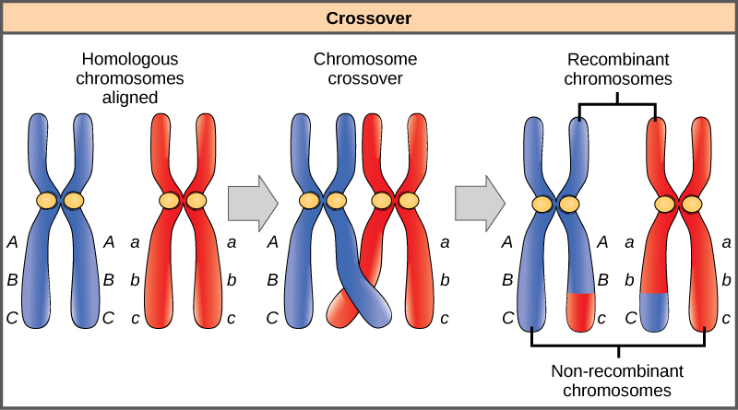
Mitotic recombination promotes LOH
What are the potential genotypes of the daughter cells after cell division?
Reciprocal translocations between homologous chromosomes
Requires DNA breaks → repair during or after replication (but probably not in mitosis)
Uses the homologous, non-sister as a repair template
Now BOTH alleles (and surrounding DNA) are derived from the same parental chromosome and both copies of the tumor suppressor have the same mutation

Slide 5
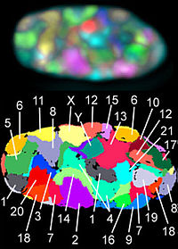
Mitotic recombination promotes LOH
Is this more likely to occur than a random secondary mutation?
Maybe…. What is required for mitotic recombination to happen?
Homologous chromosomes must be near each other in the G2 nucleus (different likelihood in different cells)
Different colored probes label each chromosomes

Slide 6
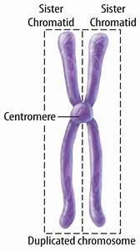
Mitotic recombination promotes LOH
Is this more likely to occur than a random secondary mutation?
Maybe…. What is required for mitotic recombination to happen?
Homologous chromosomes must be near each other in the G2 nucleus (different likelihood in different cells)
Regions farther from the centromere are more accessible for recombination

Slide 7
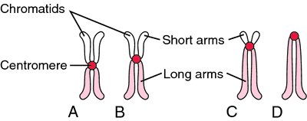
Mitotic recombination promotes LOH
In human cells, different chromosomes have different length arms → how might this impact the potential for recombination?

Slide 8
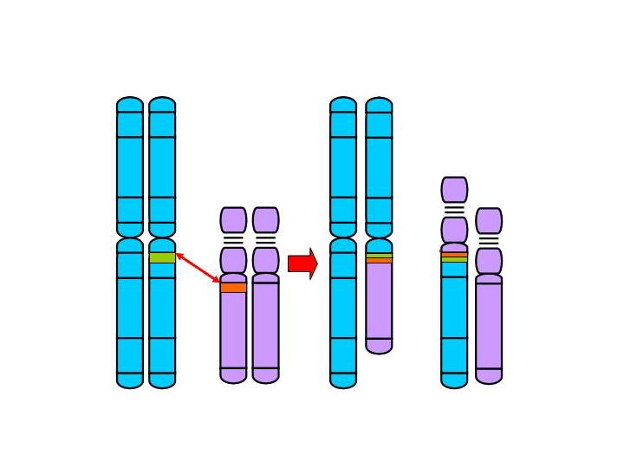
Hemizygosity to promote LOH
Loss of the wildtype allele
Break induced deletion
nonhomologous recombination events
Requires no or only small regions of homology
Chromosome fusions result in loss of genetic material
Mutations on the 2 tumor suppressor alleles are not the same
Point mutation
*
*
deletion

Slide 9
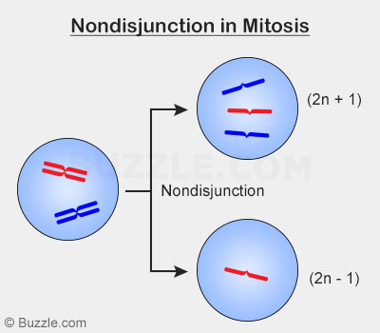
Nondisjunction to promote LOH
Failure of replicated sister chromosomes to be separated during mitotic division
What does this look like?
Requires two cell cycles
1st Mitotic segregation error → triploidy
2nd mitotic segregation error → loss of the extra (wildtype-containing) chromosome
Blue = Chromosome with a mutation
Red=Chromosome without a mutation

Slide 10
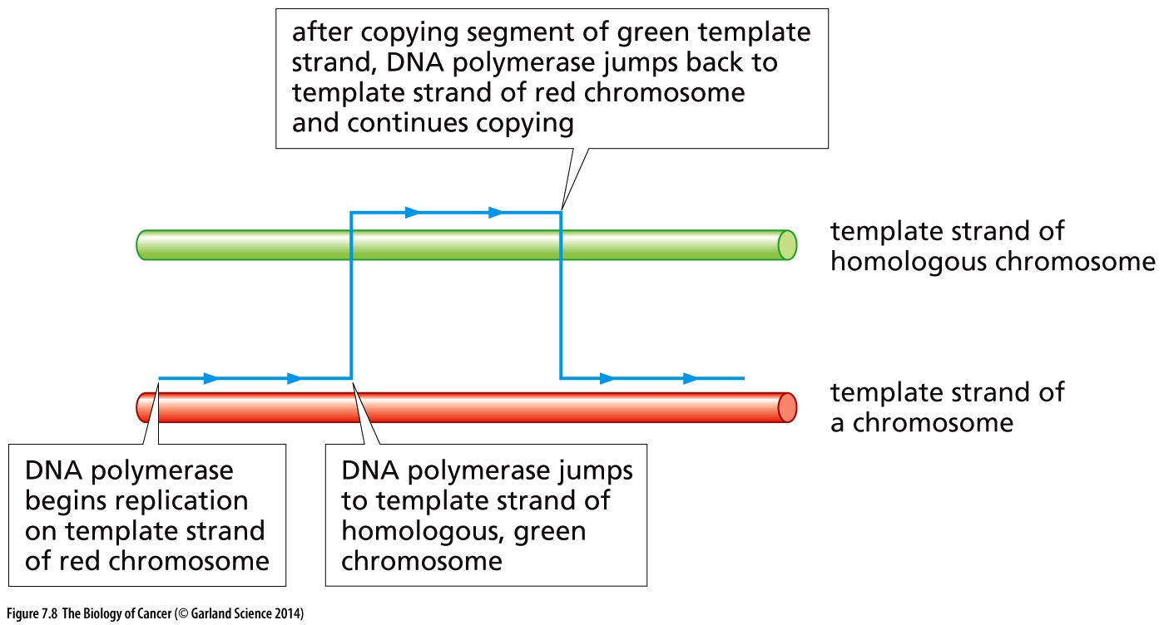
Gene conversion to promote LOH
Hopping to the homologous chromosome during replication
both copies of the tumor suppressor have the same mutation

Slide 11
Similarities and differences
LOH mechanism | # different tumor suppressor alleles? | # different non cancer gene alleles on chromosome | What stage of the cell cycle does this event happen? | changes obvious by Karyotype analysis?
Mitotic recombination
Hemizygosity
Nondisjunction
Gene Conversion

Slide 12
Similarities and differences
LOH mechanism | # different tumor suppressor alleles? | # different non cancer gene alleles on chromosome | What stage of the cell cycle does this event happen? | changes obvious by Karyotype analysis?
Mitotic recombination | 1 | 1 (for regions near TS)/2 elsewhere | During or after S phase (not mitosis) | no
Hemizygosity | 2 | 1 (in area of deletion)/2 elsewhere | During or after S phase (not mitosis) | Deletions or translocations
Nondisjunction | 1 | 1 for the whole chromosome | mitosis | Only transient copy number changes
Gene Conversion | 1 | 2 | During replication | no

Slide 13
Summary of LOH
Each mechanism to achieve LOH is rare but more likely than random mutations in each allele of the same gene
Underlying defects may favor one LOH mechanism over another
Presence of DNA damage
defects in mitotic regulation
Some genes may be more/less sensitive to LOH by one mechanism than another
position on chromosome relative to centromeres and fragile sites

Slide 14
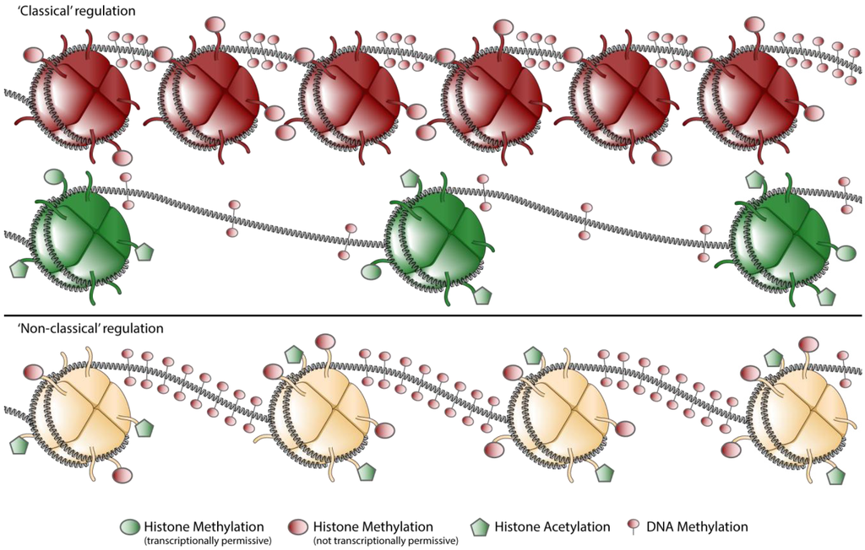
Loss of TS without gene mutations
Gene expression is regulated by chromatin compaction
Chromatin compaction is controlled by epigenetic regulation of histones and DNA
When promoters are heavily methylated the gene is transcriptionally silent
Genes not expressed
Genes expressed

Slide 15
Epigenetic mis-regulation in cancer
Mis-expression of the enzymes that regulate methylation is common in cancer
The impact of this misexpression can impact many genes (pleotropic)
EX:
DNMT3B: a DNA methyltransferase (places methyl marks on DNA) is highly expressed in colon cancer
Methylation may provide the 1st hit or the 2nd hit in loss of tumor suppressor function
Inactivation of both alleles by methylation is rare
2nd hit occurs more readily by LOH then by methylation of the second allele

Slide 16
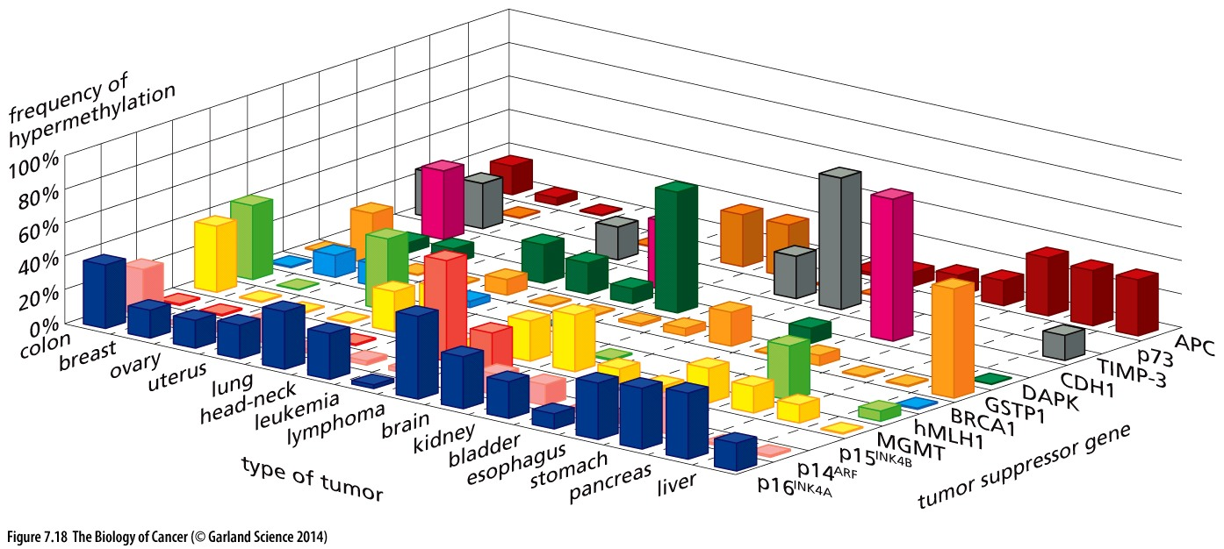
Epigentic misregulation in cancer
Common across cancer types
Impacts diverse tumor suppressor genes

Slide 17
A therapeutic window?
Genetic mutation is permanent
Epigenetic regulation is reversible
Enzymes place methyl marks
Other enzymes remove methyl marks
One methyl marks are removed, the gene can be transcribed
Cancer drugs that inhibit methyltransferase activity are actively being pursued in clinical and preclinical studies

Slide 18
Tumor suppressors: you don’t miss them ‘till their gone…
Must be lost or have an inactivating mutation in cancer
Are all genes that are lost of inactivated tumor suppressors?

Slide 19
Tumor suppressors: you don’t miss them ‘till their gone…
Must be lost or have an inactivating mutation in cancer
Not all genes that are deleted/mutated/or not expressed are tumor suppressors → may be:
located near a tumor suppressor
carrier mutation (consequence not a cause)
Developmental difference (lack of proper comparison)
Must undergo LOH (to lose BOTH copies)
Achieved through mutation or epigenetic silencing
Experimental restoration of pathological expression levels should halt tumor growth
Challenging, may halt normal cell growth as well
Engineered knockout should exhibit defects in proliferative regulation and be tumor-prone
Evidence of a cell biological/biochemical role in cell regulation?

Slide 20
Rules are meant to be broken…
Tumor suppressors normally function to limit tumor growth
tumor initiation and also malignant progression
Tumor suppressor genes encode tumor suppressor proteins
or microRNAs
The vast majority of tumor suppressors function recessively
Loss of both copies is required to provide a proliferative advantage
For some (like Nf1) haploinsufficiency provides an advantage

